Slide 1

DEPARTMENT OF COMPUTER SCIENCE AND ENGINEERING
PROJECT PHASE I – END SEMESTER REVIEW
E-waste Management System using Deep Learning
TEAM MEMBERS GUIDE
K.SUJITHA-41732006 Mrs.K.Abinya.M.E,(Ph.D)
B.MANOJKUMAR-41613005

Slide 2
AGENDA
Overview
Objective
Literature Survey
Inferences from Literature Survey
Problem Description
Proposed System
Overall Architecture
Work Flow
Methodology / Algorithm used
Conclusion
References

Slide 3
Overview
E-waste management is significantly advanced through the utilization of the YOLOv8 deep learning model, which leverages Convolutional Neural Networks (CNNs) for image detection and classification. This innovative approach aims to automate the labor-intensive processes of sorting, disassembling, and hazardous material removal in electronic waste recycling. By training the YOLOv8 model on a comprehensive dataset of e-waste images, the system achieves high efficiency and accuracy in identifying and segregating components such as circuit boards, batteries, and plastics. This method not only reduces the risks associated with manual handling but also enhances resource recovery and supports environmental sustainability. The integration of YOLOv8 into e-waste management processes contributes to a circular economy by mitigating environmental contamination and decreasing reliance on new materials.

Slide 4
OBJECTIVE
Automate E-Waste Sorting and Classification: Develop a system utilizing the YOLOv8 deep learning model to accurately and efficiently identify and categorize various e-waste components, including circuit boards, batteries, and plastics, thereby streamlining the sorting and disassembly processes.
Enhance Recycling Efficiency and Safety: Improve the recycling process by minimizing manual intervention, reducing risks associated with handling hazardous materials, and facilitating the recovery and reuse of valuable resources.
Support Environmental Sustainability: Reduce the environmental impact of e-waste disposal by providing detailed reports on identified materials and their recycling potential, promoting resource efficiency, and contributing to a cleaner, safer, and more sustainable environment.

Slide 5
LITERATURE SURVEY
A solid waste bin detection and waste level classification system that is rotation invariant is presented. Using Hough line detection and cross-correlation, the system identifies bin positions and orientations, extracts feature to determine waste levels, and checks for rubbish outside the bin. It achieves high detection and classification rates with low execution time, making it suitable for real-time applications.[1]
E-waste management is a significant challenge due to its rapid increase and potential hazards. This study, using the Australian recycling scheme, reveals that only scrap computers justify domestic recycling without subsidies and emphasizes the need for regulations and monitoring. Labor costs are highlighted as a major factor in recycling economics.[2]
Deeper neural networks are challenging to train, but our residual learning framework simplifies this by reformulating layers to learn residual functions relative to inputs. This approach, validated on the ImageNet dataset with up to 152 layers, achieved a 3.57% error rate and won the ILSVRC 2015 classification task. Additionally, deep residual nets improve performance on the COCO object detection dataset by 28%, demonstrating their importance for visual recognition tasks.[3]
In California's MRFs, e-waste treatment is costly, with materials (37%) and labor (28%) being the biggest expenses, and cathode ray tube glass recycling being the most expensive. Revenue primarily comes from customer fees and metal recovery. Technical cost modeling (TCM) assesses these economic factors.[4]

Slide 6
LITERATURE SURVEY
A proof-of-concept municipal waste management system uses deep learning classifiers and cloud computing for high-accuracy waste classification at the start of garbage collection. By subdividing recyclable waste into six categories, it employs CNNs, with MobileNetV3 achieving 94.26% accuracy. IoT devices enable real-time monitoring of waste levels and container status, aiding adaptive equipment deployment, waste collection, and vehicle routing plans.[5]
The Global E-waste Monitor 2020 reports a record 53.6 million metric tonnes of e-waste generated in 2019, with projections reaching 74 Mt by 2030. Only 17.4% of 2019's e-waste was recycled, resulting in significant losses of valuable materials worth $57 billion. Asia generated the most e-waste, followed by the Americas and Europe, with e-waste posing serious health and environmental hazards due to toxic substances[6]
Employing a Convolutional Neural Network (CNN) for automated e-waste sorting, our project focuses on optimizing accuracy through experiments with image sizes, data augmentation, and background removal. This approach reduces manual labor, supports environmental protection, and enhances recycling strategies. We aim to showcase how technology can transform electronic waste management.[7]

Slide 7
LITERATURE SURVEY
The advent of earth observation technologies has led to a surge in remote sensing images, presenting challenges in data mining. Convolutional neural networks (CNNs) offer effective solutions for remote sensing image classification, enabling rapid and accurate analysis. This survey reviews CNN advancements, datasets, and applications in scene classification, object detection, and segmentation, addressing challenges and proposing solutions to enhance remote sensing image classification research.[8]
A municipal waste management system uses deep learning classifiers and cloud computing for accurate waste classification, subdividing recyclable waste into six categories with CNNs like MobileNetV3 achieving 94.26% accuracy. IoT devices monitor waste levels and container status, enabling adaptive equipment deployment, maintenance, and efficient waste collection. This system aims to reduce costs and enhance waste management efficiency.[9]
A municipal waste management system uses deep learning and cloud computing for accurate waste classification, subdividing waste into six categories with CNNs like MobileNetV3 achieving 94.26% accuracy. IoT devices monitor waste levels and container status, enabling efficient scheduling of equipment, maintenance, and collection routes. This approach aims to reduce costs and improve waste management efficiency.[10]

Slide 8
INFERENCES FROM LITERATURE SURVEY
Author & Journal name | Title | Existing techniques | Drawbacks
1. Ethan P. Zhou, | MACHINE LEARNING FOR CLASSIFICATION AND SEPARATION OF E-WASTE | The CNN model was trained with 132 color images and validated on 32, achieving a training accuracy of 96.9% and a validation accuracy of 93.9%. Background removal significantly improved classification performance, while data augmentation, such as rotation, had a lesser impact. Real-world demonstrations confirmed the model's reliability, achieving a consistent accuracy rate of 90% and highlighting its practical effectiveness in e-waste management. | The CNN model’s reliance on a limited dataset of 132 images may restrict its ability to generalize across diverse conditions. Background removal, while beneficial, may not address all real-world variations, and data augmentation techniques showed limited improvement. Additionally, the model’s performance, though impressive, could be impacted by potential overfitting due to the relatively small training set.

Slide 9
INFERENCES FROM LITERATURE SURVEY
Author & Journal name | Title | Existing techniques | Drawbacks
2. Md. Kishor Morol, Shuvra Smaran Das , Dip Nandi | ConvoWaste: An Automatic Waste Segregation Machine Using Deep Learning | The system integrates real-time waste detection and sorting by employing a processing unit that communicates with a servo motor controller for accurate waste segregation. It features a cantilever mechanism that returns to its original position after each sorting action, ensuring operational efficiency. Additionally, a display module outputs the waste type and bin number, facilitating effective monitoring and management of waste bins. | The system may face limitations due to potential delays in real-time communication between the processing unit and servo motor controller, affecting sorting speed. The cantilever mechanism’s return to the initial position might experience mechanical wear or misalignment over time, impacting reliability. Additionally, the display module’s accuracy in outputting waste type and bin number could be affected by system malfunctions or errors in waste detection. 4o mini

Slide 10
INFERENCES FROM LITERATURE SURVEY
Author & Journal name | Title | Existing techniques | Drawbacks
3. S. Elangovan, S. Sasikala, S. Arun Kumar, M. Bharathi, E. Naveen Sangath | A Deep Learning Based Multiclass Segregation of E-waste using Hardware Software Co-Simulation | Using a pretrained ResNet-18 model for classifying waste into eight categories with TensorFlow allows for efficient machine learning with minimal GPU resources and reduced training time. The NVIDIA Jetson Nano, featuring a 128-bit GPU and a 64-bit Quad Core ARM Cortex-A57 processor, supports effective deep learning and real-time image processing, achieving an average classification accuracy of 93%. | Using a pretrained model for waste classification may limit customization, as it might not be optimized for specific waste categories or local conditions. The reliance on TensorFlow and the ResNet-18 model can lead to performance issues if the pretrained model's assumptions do not align with the specific dataset or application requirements. Additionally, while the NVIDIA Jetson Nano offers powerful processing capabilities, it may struggle with very large datasets or real-time processing requirements, potentially impacting performance and efficiency.

Slide 11
INFERENCES FROM LITERATURE SURVEY
Author & Journal name | Title | Existing techniques | Drawbacks
4. Aziz, F., Arof, H., Mokhtar, N., Mubin, M., Abu Talip, M.S. | Rotation invariant bin detection and solid waste level classification. | Existing techniques include Hough line detection and cross correlation for identifying bin locations and orientations while distinguishing them from similar objects. Feature extraction, using rotated Sobel or Gabor filters, helps determine bin waste levels and detect rubbish outside the bin. Classification methods such as MLP and SVMs are employed to accurately classify the waste levels as empty, partially full, or full. | Drawbacks of the proposed system include potential inaccuracies in Hough line detection and cross correlation, especially when bins are obscured by other objects, leading to false detections. The feature extraction process may struggle with variations in lighting and bin conditions, affecting accuracy. Additionally, the classification performance of MLP and SVMs depends on the quality and diversity of the training data, which could limit their effectiveness in real-world scenarios.

Slide 12
INFERENCES FROM LITERATURE SURVEY
Author & Journal name | Title | Existing techniques | Drawbacks
5. Kavana KM, Suma N R | RECOGNIZATION OF HAND GESTURESUSING MEDIAPIPE HANDS” | On traditional input devices like physical mice, keyboards, and controllers, which can be limiting in various scenarios such as gaming, presentations, and exercise. Many systems utilize basic voice recognition and gesture controls but lack comprehensive integration for diverse tasks and secure authentication. Current solutions may also struggle with accuracy and error handling in gesture and voice-based interactions. | The implementation may face challenges including potential inaccuracies in gesture and voice recognition, which could lead to user frustration. Hardware dependencies like webcams and microphones may not always function optimally, affecting system performance. Additionally, complex authentication methods and error handling mechanisms might introduce delays or complications in user interactions.

Slide 13
INFERENCES FROM LITERATURE SURVEY
Author & Journal name | Title | Existing techniques | Drawbacks
6. Krizhevsky, A., Sutskever, I., & Hinton, G. E. | ImageNet classification with deep convolutional neural networks | Object recognition relies on convolutional neural networks (CNNs) to manage large-scale datasets like ImageNet, which includes millions of labeled images across thousands of categories. To overcome limitations of smaller datasets, models are trained on extensive data using GPUs and optimized 2D convolution techniques to handle complexity and reduce overfitting. Advanced methods such as data augmentation and regularization are also used to improve model performance and generalization. | Despite advances with large datasets like ImageNet and powerful CNNs, challenges include the prohibitive computational cost and time required for training high-resolution images. The risk of overfitting remains significant even with large datasets, necessitating effective regularization techniques. Additionally, the reliance on GPU memory limits the feasible size and depth of networks, constraining model complexity and scalability.

Slide 14
INFERENCES FROM LITERATURE SURVEY
Author & Journal name | Title | Existing techniques | Drawbacks
7. Dasl, Aditya & Gawde, Shantanu & Suratwala, Khyati & Kalbande, Dhananjay. | Sign Language Recognition Using Deep Learning on Custom Processed Static Gesture Images. | Gesture-based sign language recognition typically utilize traditional CNN architectures like VGG-11 and VGG-16, which offer varying degrees of classification accuracy but with larger model sizes and parameters. Prior methods often rely on basic image datasets for training and do not consistently address invariance to transformations such as rotation and scaling. State-of-the-art techniques are limited by their complexity and accuracy, particularly in achieving high performance across diverse sign language datasets. | Systems often suffer from high computational demands due to large model sizes and parameters, which can slow down training and inference. They may also struggle with invariance to transformations like rotation and scaling, leading to reduced accuracy in real-world scenarios. Additionally, traditional architectures may not consistently achieve the highest classification performance across diverse datasets, impacting overall robustness and reliability.

Slide 15
INFERENCES FROM LITERATURE SURVEY
Author & Journal name | Title | Existing techniques | Drawbacks
8. M. H. O'Malley | Text-to-speech conversion technology | Contemporary text-to-speech (TTS) systems leverage advanced vocal tract models and algorithms to convert text into speech with high fidelity. Key techniques include text normalization, which ensures accurate pronunciation and prosody, and phonetic rule application to refine speech synthesis. Prominent examples include Berkeley Speech Technologies' T-T-S system, which exemplifies state-of-the-art approaches in TTS technology. | Text-to-speech (TTS) systems can be limited by their reliance on complex vocal tract models and extensive text normalization, which may not fully capture natural speech nuances. Challenges include achieving consistent prosody and accurate pronunciation across diverse languages and contexts. Additionally, hardware constraints and the need for extensive voice tables can restrict real-time performance and scalability.

Slide 16
INFERENCES FROM LITERATURE SURVEY
Author & Journal name | Title | Existing techniques | Drawbacks
9. Song J, Gao S, Zhu Y, Ma C. | A survey of remote sensing image classification based on CNNs | Remote sensing image classification include parametric classifiers, such as maximum likelihood, which struggle with high-dimensional data. Non-parametric methods like Support Vector Machines (SVMs) handle complex features but face limitations with shallow feature design. Deep learning models, especially Convolutional Neural Networks (CNNs) like AlexNet and ResNet, excel in extracting advanced features and achieving high accuracy. | Parametric classifiers, such as maximum likelihood, often fail to handle the complexity of high-dimensional remote sensing data and are inflexible with integrating auxiliary information. Non-parametric methods like Support Vector Machines (SVMs) suffer from limited feature extraction capabilities due to their shallow architecture, making it difficult to capture intricate data relationships. Deep learning models, while powerful, require extensive training data and computational resources and can be prone to overfitting if not properly regularized.

Slide 17
INFERENCES FROM LITERATURE SURVEY
Author & Journal name | Title | Existing techniques | Drawbacks
10. Wang C, Qin J, Qu C, Ran X, Liu C, Chen B | A smart municipal waste management system based on deep-learning and Internet of Things | The municipal waste management system uses CNN-based deep learning for waste classification, with MobileNetV3 achieving 94.26% accuracy, compact size, and quick processing. It employs advanced data pre-processing and CNN architectures, reaching classification accuracies of 91.9% to 94.6%. IoT devices are used for monitoring waste containers and optimizing collection and routing based on real-time data. | The system's reliance on deep learning and CNNs may lead to high computational costs and require significant data for training to maintain accuracy. MobileNetV3, while efficient, might struggle with diverse or complex waste types not well-represented in the training data. Additionally, IoT devices depend on stable network connectivity, which can be problematic in areas with poor coverage.

Slide 18
PROBLEM DESCRIPTION
Enhanced Accuracy and Efficiency: The YOLOv8 model boosts the precision of e-waste identification and categorization for more effective recycling.
Automation of Labor-Intensive Tasks: The software automates e-waste sorting and disassembly, reducing manual effort and errors.
Improved Safety and Risk Reduction: Automation minimizes risks by reducing human exposure to hazardous materials, enhancing worker safety.
Resource Recovery and Environmental Impact: The system improves resource recovery and lowers environmental impact by efficiently separating recyclable components.
Detailed Reporting and Insights: It provides in-depth reports on e-waste types and quantities, aiding in process optimization and resource management.
Sustainable E-Waste Management

Slide 19
PROPOSED SYSTEM
The proposed e-waste management system utilizes a multi-stage architecture for efficient e-waste identification. It starts by capturing real-time images with OpenCV, which are then processed using a CNN algorithm to detect and classify e-waste. The system extracts relevant features, applies the YOLOv8 model to categorize e-waste based on an existing dataset, and finally generates a detailed report on the identified e-waste, including its category and quantity, which is sent to a specified email.
Advantages of Proposed System
Accurate Identification and Classification
Automation and Efficiency
Enhanced Safety
Real-Time Processing
Detailed Reporting

Slide 20
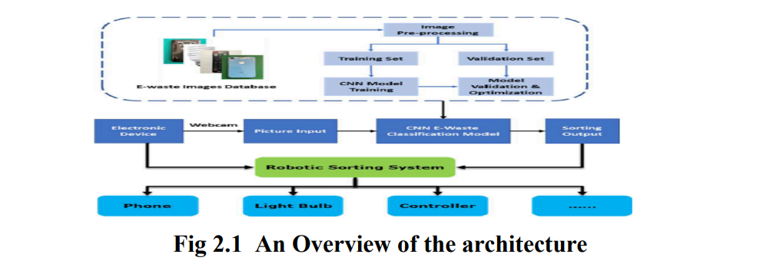
System Architecture

Slide 21
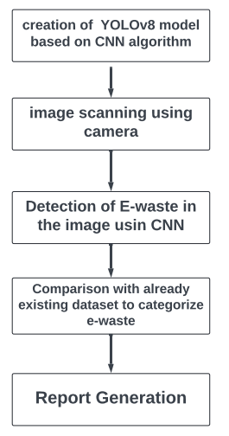
Work Flow
Creating a YOLOv8 model based on CNN
Capture pictures of electronic items for e-waste detection.
Draw boxes around identified e-waste.
Compare image with existing dataset to classify waste
Generate a report detailing e-waste classification, reusability, recyclability, and hazards.

Slide 22
Methodology/Algorithm Used
Requirement Gathering and Analysis: Ensures a clear understanding of project objectives and user needs by meticulously analyzing initial requirements.
Iterative Design, Development, and Testing: Involves cycles of design, development, and testing to emphasize continuous improvement and flexibility.
Regular Communication and Stakeholder Engagement: Maintains alignment with project objectives through regular communication and active engagement with stakeholders.
Use of Deep Learning and CNN: Utilizes deep learning algorithms, particularly CNNs like the YOLOv8 model, for effective e-waste management.
Prediction and Analysis: Uses the RESNET-18 algorithm and SoftMax function for accurate categorization of electronic components and quantitative analysis.

Slide 23
WORK TO BE DONE
In our investigation confirms YOLOv8's leading position in object detection due to its remarkable balance of accuracy and speed, achieved through its single-stage architecture and efficient feature extraction methods.
The model excels in real-time data processing and delivers superior performance across diverse datasets, making it an optimal choice for swift detection applications.
Our results, demonstrated by high precision, recall, F1 score, and mean average precision (mAP), affirm YOLOv8's reliability for real-world challenges. This study highlights YOLOv8's adaptability and practical applicability, providing valuable insights for future research and decision-making in the field of computer vision.

Slide 24
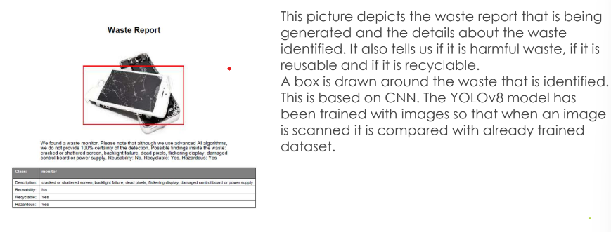
WORK TO BE DONE

Slide 25
REFERENCES
[1] Aziz, F., Arof, H., Mokhtar, N., Mubin, M., Abu Talip, M.S., 2015. Rotation invariant bin detection and solid waste level classification. Measurement 65, 19–28.
[2] Dias P, Bernardes AM, Huda N. “Ensuring best E-waste recycling practices in developed countries: An Australian example”. J Clean Prod. 2019 Feb 1; 209: 846-54.
[3] Forti V, Balde CP, Kuehr R, Bel G. “The global e-waste monitor 2020: Quantities, flows and the circular economy potential”.
[4] He, K., Zhang, X., Ren, S., & Sun, J. (2016). Deep residual learning for image recognition. In Proceedings of the IEEE conference on computer vision and pattern recognition (pp. 770-778).
[5] Kang HY, Schoenung JM. “Economic analysis of electronic waste recycling: modeling the cost and revenue of a materials recovery facility in California”. Environ Sci Technol. 2006 Mar 1;40(5):1672-80. doi: 10.1021/es0503783. PMID: 16568786.

Slide 26
REFERENCES
[6] Krizhevsky, A., Sutskever, I., & Hinton, G. E. (2012). ImageNet classification with deep convolutional neural networks. In Advances in neural information processing systems (pp. 1097-1105).
[7] LeCun, Y., Bengio, Y., & Hinton, G. (2015). Deep learning. Nature, 521(7553), 436–444.
[8] Song J, Gao S, Zhu Y, Ma C. “A survey of remote sensing image classification based on CNNs”. Big Earth Data. 2019, Sep 12; 3(3): 232-54, doi: 10.1080/20964471.2019.1657720.
[9] Wang C, Qin J, Qu C, Ran X, Liu C, Chen B. “A smart municipal waste management system based on deep-learning and Internet of Things”. Waste Management. 2021 Nov 1;135:20-9.
[10] Earth911. “20 staggering e-waste facts in 2021”.

Slide 27
THANK YOU
We thank God, Our Department, Guide, Panel Members, Supportive Professors and all Technical and non Technical staff who helped us in our Project.

